Slide 1


Newyddion
Mis Tachwedd 2024

Slide 2
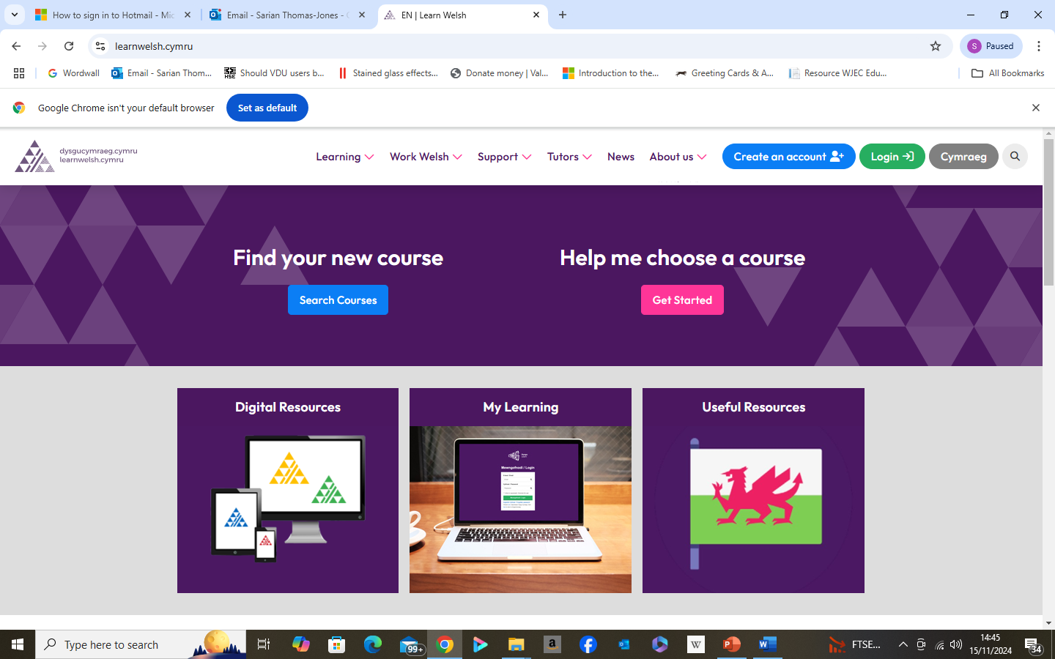
My Learning / Fy Nysgu
Fideo Cymraeg: Adnodd | Dysgu Cymraeg
Fideo Saesneg: Resource | Learn Welsh

Slide 3
Calendr 24/25
https://dysgucymraeg.cymru/media/17999/calendr-24-25-cymraeg-medi.pdf
https://dysgucymraeg.cymru/media/17998/calendar-24-25-saesneg-medi.pdf

Slide 4
I’ch helpu chi!
Youtube
Duolingo
Say Something in Welsh
bbc.co.uk/dysgucymraeg
(20+) ‪#‎doctorcymraeg‬ - Archwilio | Facebook
https://www.valeofglamorgan.gov.uk/en/enjoying/Libraries/Libraries.aspx
https://community-courses.memrise.com/

Slide 5

Boreau Coffi / Coffee mornings
Dydd Llun 11 - 11.30 a Dydd Gwener 11 – 11.30
https://zoom.us/j/94882731882?pwd=PlZiTkYmYvT2g9BNTD4NSc5DRabtYw.1
Siawns i ymarfer neu gael sgwrs fach yn Gymraeg
A chance to practise or have a little chat in Welsh

Slide 6


Slide 7
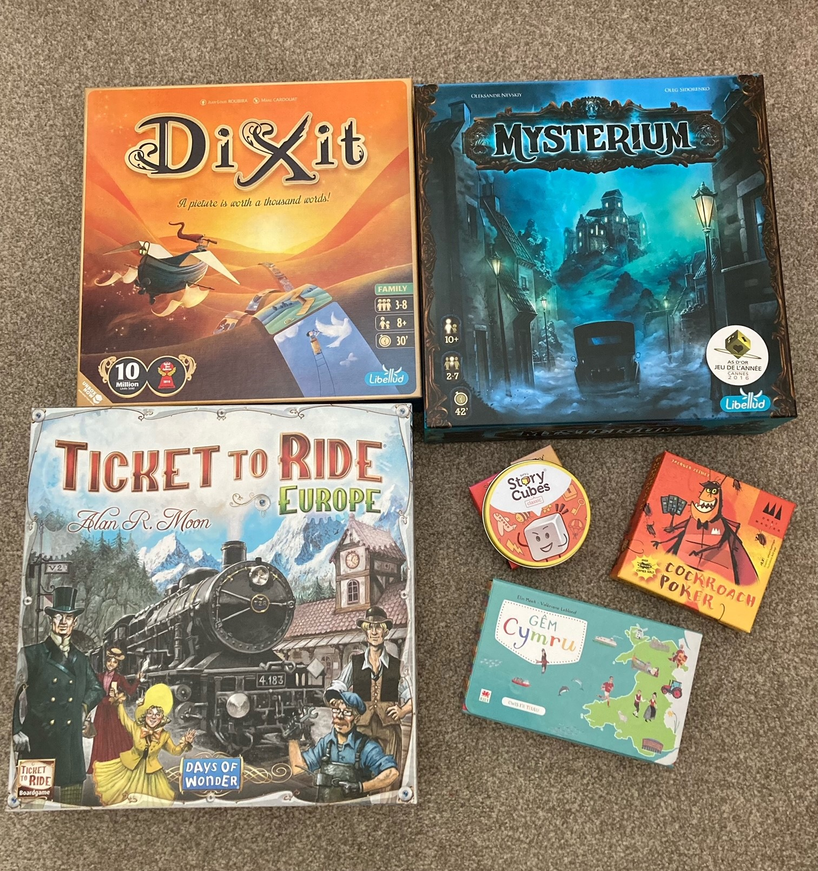
Clwb Gemau
Dych chi’n hoffi chwarae gemau bwrdd?
nos Wener/dydd Sadwrn
Firestorm Games, Caerdydd
Llyfrgell, y Barri
Os oes diddordeb, cysyllta â fi neu Nick Farnham (isod)
nvfarnham@googlemail.com

Slide 8


Slide 9
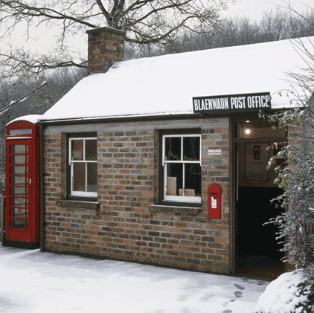
Taith Nadolig i Sain Ffagan
17/12/24 Dydd Mawrth
12.00 (Hanner Dydd) - Prif Fynedfa

Slide 10
Dosbarthiadau Newydd Mis Ionawr
January 2025 Courses
Day | Level | Time | Start Date | Work Code | Link
Friday | Beginners | 12:30 - 3:00pm | 10/01/25 | GWAITHM15/yf-47620 | Register - Beginners
Wednesday | Foundation | 10:00 - 12:30pm | 05/01/25 | GWAITHS15/yf47622 | Register - Foundation
Tuesday | Intermediate | 12:30 - 3:00pm | 07/01/25 | GWAITHCC1/yf46751 | Register - Intermediate

Slide 11


Slide 12

Nant Gwrtheyrn
Cyrsiau preswyl a rhithiol ar gael!
Cyrsiau dan ofal tiwtoriaid profiadol, ar lefelau Canolradd, Uwch a Gloywi dros gyfnod o 5 niwrnod (Llun – Gwener).
WEDI EU CYLLIDO'N LLAWN!
Residential and virtual courses available!
Intermediate, Advanced and Proficiency level, tutor-led courses available over a period of 5 days (Monday – Friday).
FULLY-FUNDED!
Am fwy o wybodaeth, cysylltwch â ni drwy eich cyflogwr drwy e-bostio
cymraeggwaith@nantgwrtheyrn.org
For more information, contact us through your employer by e-mailing
cymraeggwaith@nantgwrtheyrn.org

Slide 13
Hen bapurau
Mynediad
https://www.wjec.co.uk/qualifications/welsh-for-adults-entry/#tab_keydocuments
Sylfaen
https://www.wjec.co.uk/qualifications/welsh-for-adults-foundation/#tab_keydocuments
Canolradd
https://www.wjec.co.uk/qualifications/welsh-for-adults-intermediate/#tab_keydocuments
Uwch
https://www.wjec.co.uk/qualifications/welsh-for-adults-advanced/#tab_keydocuments

Slide 14

Sarian Thomas-Jones
Work Welsh Co-ordinator/Cydlynydd Cymraeg Gwaith
Learning and Skills Directorate / Cyfarwyddiaeth Dysgu a Sgiliau
Vale of Glamorgan Council / Cyngor Bro Morgannwg
tel / ffôn: 07936 601 188
e-mail / e-bost: sthomas-jones@valeofglamorgan.gov.uk
dysgucymraeg.cymru/yfro
learnwelsh@valeofglamorgan.gov.uk
01446 730402

