Slide 1


Newyddion
Mis Rhagfyr 2024

Slide 2


Slide 3
Gwyliau
Diwedd y tymor 13/12/24
Dechrau’r tymor 6/1/25

Slide 4
Dosbarthiadau Newydd Mis Ionawr
January 2025 Courses
Day | Level | Time | Start Date | Work Code | Link
Llun Monday | Mynediad Beginners | 9.00 – 11.30am | 06/01/25 | GWAITHM15/yf-47620 | Register - Beginners
Mercher Wednesday | Sylfaen Foundation | 10:00 - 12:30pm | 08/01/25 | GWAITHS15/yf47622 | Register - Foundation
Mawrth Tuesday | Canolradd Intermediate | 12:30 - 3:00pm | 07/01/25 | GWAITHCC1/yf46751 | Register - Intermediate

Slide 5


Slide 6
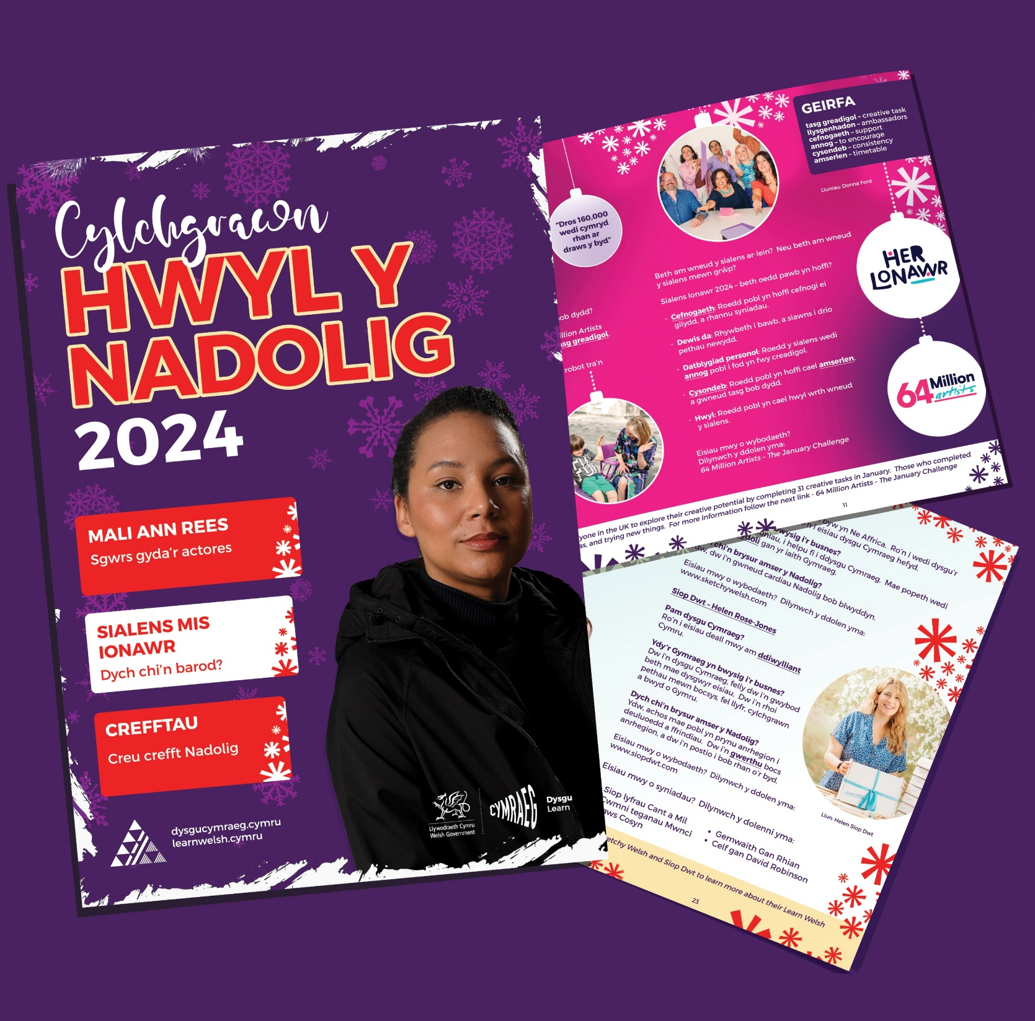

Slide 7

https://dysgucymraeg.cymru/newyddion/y-ganolfan-dysgu-cymraeg-genedlaethol-a-r-cylchgrawn-barn-yn-cynnal-sesiwn-ar-lein/

Slide 8

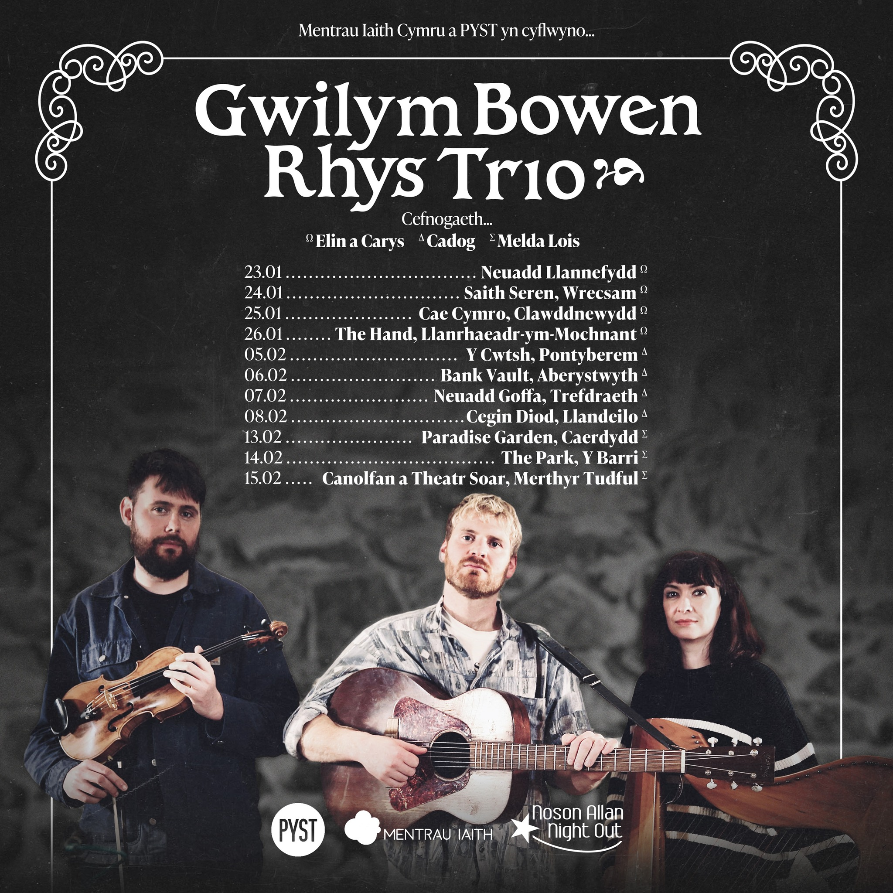
https://linktr.ee/mentrauiaithpyst

Slide 9
I’ch helpu chi!
Youtube
Duolingo
Say Something in Welsh
bbc.co.uk/dysgucymraeg
(20+) ‪#‎doctorcymraeg‬ - Archwilio | Facebook
https://www.valeofglamorgan.gov.uk/en/enjoying/Libraries/Libraries.aspx
https://community-courses.memrise.com/
https://dysgucymraeg.cymru/media/17999/calendr-24-25-cymraeg-medi.pdf
https://dysgucymraeg.cymru/media/17998/calendar-24-25-saesneg-medi.pdf

Slide 10
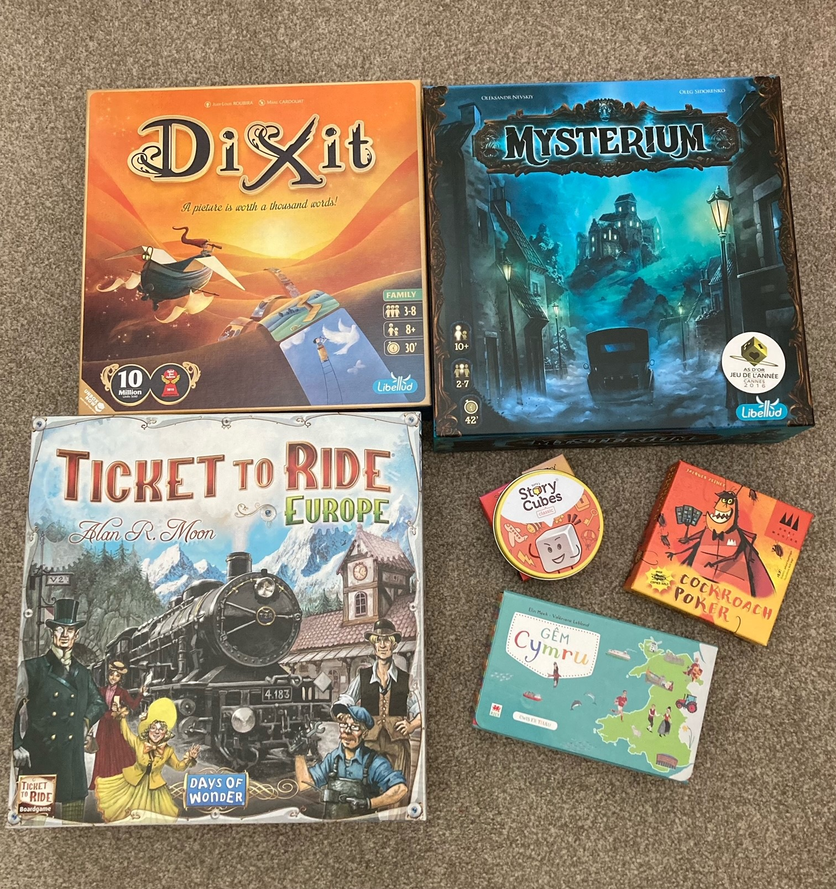
Clwb Gemau
Dych chi’n hoffi chwarae gemau bwrdd?
nos Wener/dydd Sadwrn
Firestorm Games, Caerdydd
Llyfrgell, y Barri
Os oes diddordeb, cysyllta â fi neu Nick Farnham (isod)
nvfarnham@googlemail.com

Slide 11
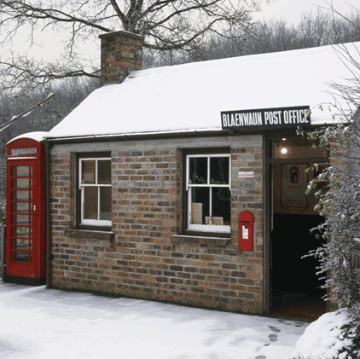
Taith Nadolig i Sain Ffagan
17/12/24 Dydd Mawrth
12.00 (Hanner Dydd) - Prif Fynedfa

Slide 12
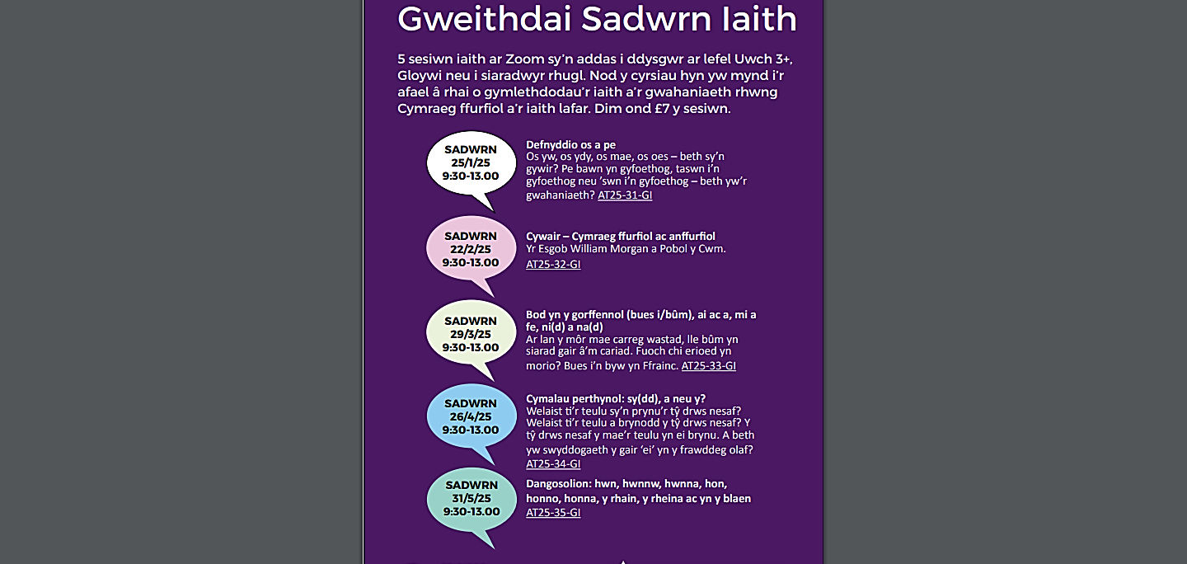

Slide 13


Slide 14

Nant Gwrtheyrn
Cyrsiau preswyl a rhithiol ar gael!
Cyrsiau dan ofal tiwtoriaid profiadol, ar lefelau Canolradd, Uwch a Gloywi dros gyfnod o 5 niwrnod (Llun – Gwener).
WEDI EU CYLLIDO'N LLAWN!
Residential and virtual courses available!
Intermediate, Advanced and Proficiency level, tutor-led courses available over a period of 5 days (Monday – Friday).
FULLY-FUNDED!
Am fwy o wybodaeth, cysylltwch â ni drwy eich cyflogwr drwy e-bostio
cymraeggwaith@nantgwrtheyrn.org
For more information, contact us through your employer by e-mailing
cymraeggwaith@nantgwrtheyrn.org

Slide 15

Sarian Thomas-Jones
Work Welsh Co-ordinator/Cydlynydd Cymraeg Gwaith
Learning and Skills Directorate / Cyfarwyddiaeth Dysgu a Sgiliau
Vale of Glamorgan Council / Cyngor Bro Morgannwg
tel / ffôn: 07936 601 188
e-mail / e-bost: sthomas-jones@valeofglamorgan.gov.uk
dysgucymraeg.cymru/yfro
learnwelsh@valeofglamorgan.gov.uk
01446 730402

Slide 17
Hen bapurau
Mynediad
https://www.wjec.co.uk/qualifications/welsh-for-adults-entry/#tab_keydocuments
Sylfaen
https://www.wjec.co.uk/qualifications/welsh-for-adults-foundation/#tab_keydocuments
Canolradd
https://www.wjec.co.uk/qualifications/welsh-for-adults-intermediate/#tab_keydocuments
Uwch
https://www.wjec.co.uk/qualifications/welsh-for-adults-advanced/#tab_keydocuments

