Slide 1


Newyddion
Mis Mawrth 2025

Slide 2


Slide 3


Slide 4


Slide 5


Slide 6

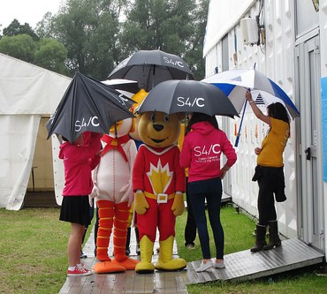
https://eisteddfod.cymru/yrwyl/2025/cystadlu/maes-d
This Photo by Unknown Author is licensed under CC BY-NC-ND

Slide 7
I’ch helpu chi!
Mynediad https://www.youtube.com/watch?v=UxxbORfXqRc&list=PLAXFFbL48HbJm6hvCEkMUMLl9MmGiwt7B
Sylfaen https://www.youtube.com/watch?v=L0dV1aFw7uE&list=PLAXFFbL48HbIVDI7ezZ3hhrU1SJUQmEcv
Duolingo https://www.duolingo.com/course/cy/en/Learn-Welsh
Say Something in Welsh https://en.saysomethingin.com/welsh/level1
bbc.co.uk/dysgucymraeg https://www.bbc.co.uk/cymrufyw
(20+) ‪#‎doctorcymraeg‬ - Archwilio | Facebook
https://www.valeofglamorgan.gov.uk/en/enjoying/Libraries/Libraries.aspx
https://community-courses.memrise.com/
https://dysgucymraeg.cymru/media/17999/calendr-24-25-cymraeg-medi.pdf
https://dysgucymraeg.cymru/media/17998/calendar-24-25-saesneg-medi.pdf

Slide 8
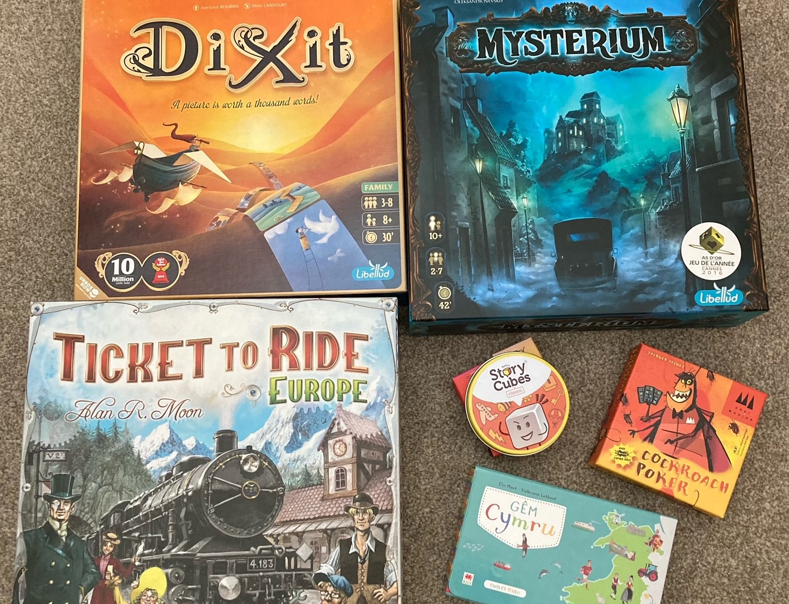
Clwb Gemau
Dych chi’n hoffi chwarae gemau bwrdd?
nos Wener/dydd Sadwrn
Firestorm Games, Caerdydd
Llyfrgell, y Barri
Os oes diddordeb, cysyllta â fi neu Nick Farnham (isod)
nvfarnham@googlemail.com

Slide 9

Nant Gwrtheyrn
Cyrsiau preswyl a rhithiol ar gael!
Cyrsiau dan ofal tiwtoriaid profiadol, ar lefelau Canolradd, Uwch a Gloywi dros gyfnod o 5 niwrnod (Llun – Gwener).
WEDI EU CYLLIDO'N LLAWN!
Residential and virtual courses available!
Intermediate, Advanced and Proficiency level, tutor-led courses available over a period of 5 days (Monday – Friday).
FULLY-FUNDED!
Am fwy o wybodaeth, cysylltwch â ni drwy eich cyflogwr drwy e-bostio
cymraeggwaith@nantgwrtheyrn.org
For more information, contact us through your employer by e-mailing
cymraeggwaith@nantgwrtheyrn.org

Slide 10
Hen bapurau
Mynediad
https://www.wjec.co.uk/qualifications/welsh-for-adults-entry/#tab_keydocuments
Sylfaen
https://www.wjec.co.uk/qualifications/welsh-for-adults-foundation/#tab_keydocuments
Canolradd
https://www.wjec.co.uk/qualifications/welsh-for-adults-intermediate/#tab_keydocuments
Uwch
https://www.wjec.co.uk/qualifications/welsh-for-adults-advanced/#tab_keydocuments

Slide 11
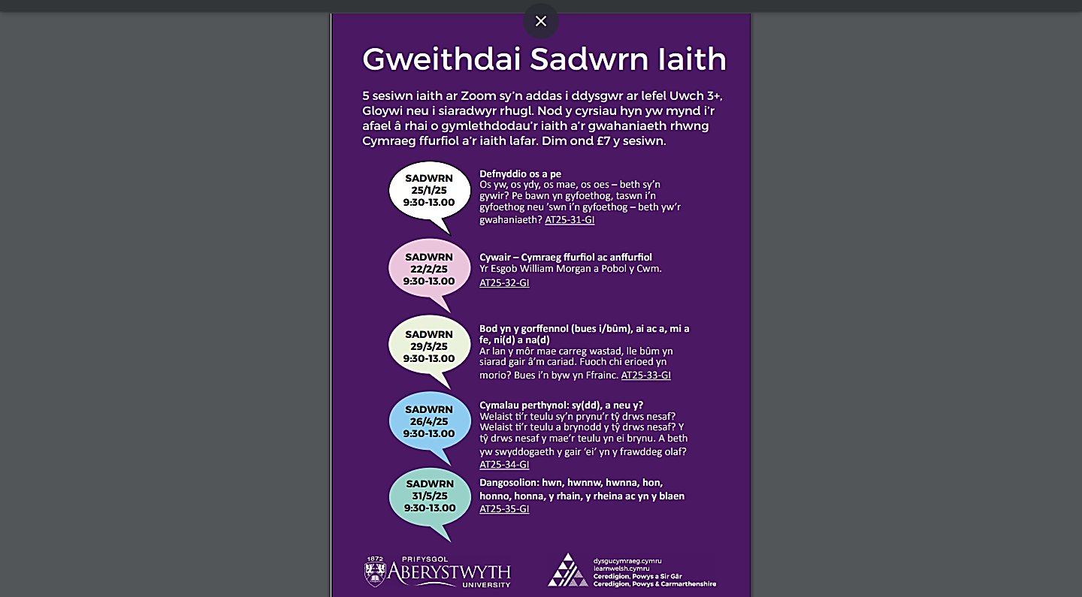

Slide 12
Prifysgol Aberystwyth
https://www.aber.ac.uk/cy/lifelong-learning/welsh-medium/

Slide 13

Sarian Thomas-Jones
Work Welsh Co-ordinator/Cydlynydd Cymraeg Gwaith
Learning and Skills Directorate / Cyfarwyddiaeth Dysgu a Sgiliau
Vale of Glamorgan Council / Cyngor Bro Morgannwg
tel / ffôn: 07936 601 188
e-mail / e-bost: sthomas-jones@valeofglamorgan.gov.uk
dysgucymraeg.cymru/yfro
learnwelsh@valeofglamorgan.gov.uk
01446 730402

