Slide 1


Newyddion
Mis Chwefror 2025

Slide 2
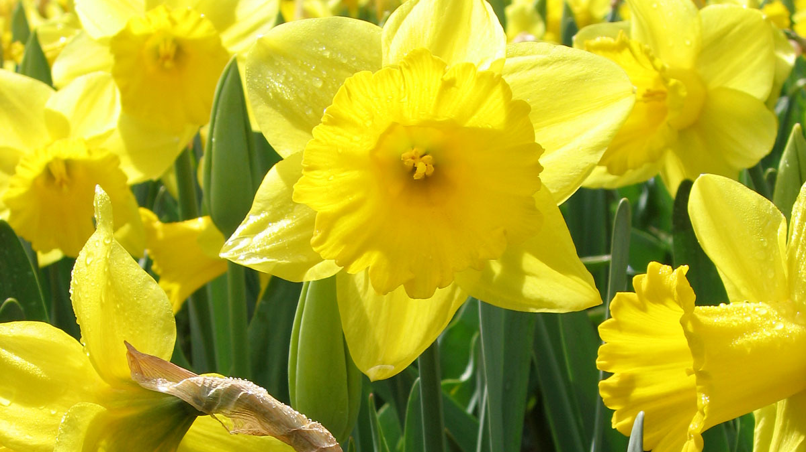
HANNER TYMOR HALF TERM
24 – 28 Chwefror February
This Photo by Unknown Author is licensed under CC BY-SA

Slide 3
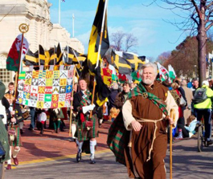
Dydd Gwyl Dewi Hapus!
Cynhelir Gorymdaith Dydd Gŵyl Dewi
eleni ar ddydd Sadwrn, Mawrth 1af 2025.
Byddwn yn ymgynnull am 12.00 canol dydd
yn Rhodfa Brenin Edward VII, ger Boulevard de Nantes
ac yn cychwyn am 12.30 y prynhawn

Slide 4

https://learnwelsh.cymru/learning/amdani-festival-of-reading
/

Slide 5


Slide 6

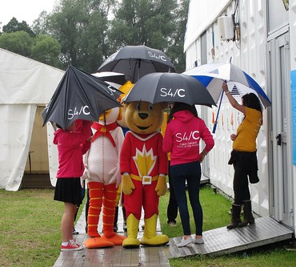
https://eisteddfod.cymru/yrwyl/2025/cystadlu/maes-d
This Photo by Unknown Author is licensed under CC BY-NC-ND

Slide 7


Slide 8
I’ch helpu chi!
Mynediad https://www.youtube.com/watch?v=UxxbORfXqRc&list=PLAXFFbL48HbJm6hvCEkMUMLl9MmGiwt7B
Sylfaen https://www.youtube.com/watch?v=L0dV1aFw7uE&list=PLAXFFbL48HbIVDI7ezZ3hhrU1SJUQmEcv
Duolingo https://www.duolingo.com/course/cy/en/Learn-Welsh
Say Something in Welsh https://en.saysomethingin.com/welsh/level1
bbc.co.uk/dysgucymraeg https://www.bbc.co.uk/cymrufyw
(20+) ‪#‎doctorcymraeg‬ - Archwilio | Facebook
https://www.valeofglamorgan.gov.uk/en/enjoying/Libraries/Libraries.aspx
https://community-courses.memrise.com/
https://dysgucymraeg.cymru/media/17999/calendr-24-25-cymraeg-medi.pdf
https://dysgucymraeg.cymru/media/17998/calendar-24-25-saesneg-medi.pdf

Slide 9
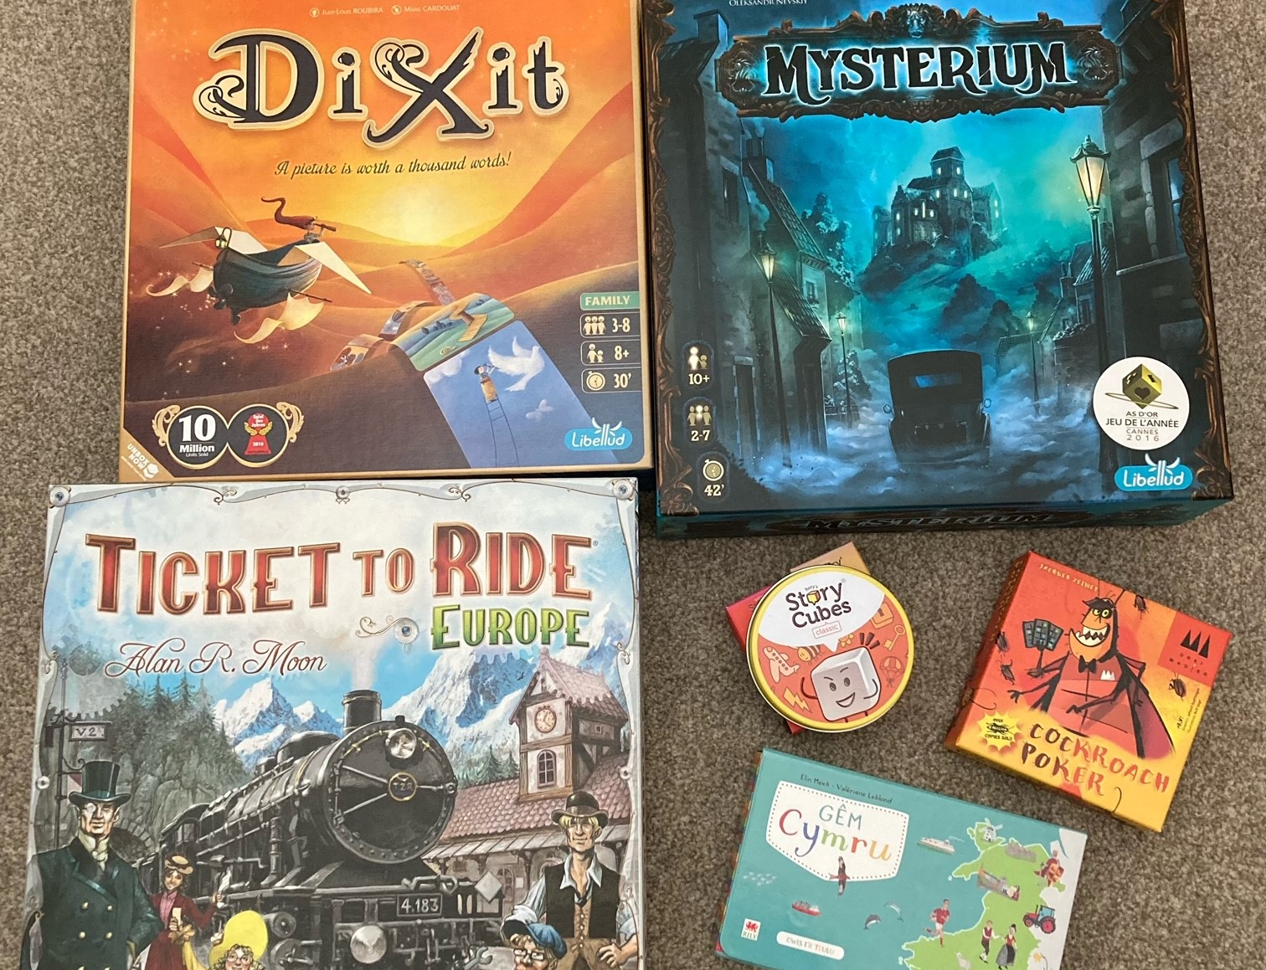
Clwb Gemau
Dych chi’n hoffi chwarae gemau bwrdd?
nos Wener/dydd Sadwrn
Firestorm Games, Caerdydd
Llyfrgell, y Barri
Os oes diddordeb, cysyllta â fi neu Nick Farnham (isod)
nvfarnham@googlemail.com

Slide 10

Nant Gwrtheyrn
Cyrsiau preswyl a rhithiol ar gael!
Cyrsiau dan ofal tiwtoriaid profiadol, ar lefelau Canolradd, Uwch a Gloywi dros gyfnod o 5 niwrnod (Llun – Gwener).
WEDI EU CYLLIDO'N LLAWN!
Residential and virtual courses available!
Intermediate, Advanced and Proficiency level, tutor-led courses available over a period of 5 days (Monday – Friday).
FULLY-FUNDED!
Am fwy o wybodaeth, cysylltwch â ni drwy eich cyflogwr drwy e-bostio
cymraeggwaith@nantgwrtheyrn.org
For more information, contact us through your employer by e-mailing
cymraeggwaith@nantgwrtheyrn.org

Slide 11
Hen bapurau
Mynediad
https://www.wjec.co.uk/qualifications/welsh-for-adults-entry/#tab_keydocuments
Sylfaen
https://www.wjec.co.uk/qualifications/welsh-for-adults-foundation/#tab_keydocuments
Canolradd
https://www.wjec.co.uk/qualifications/welsh-for-adults-intermediate/#tab_keydocuments
Uwch
https://www.wjec.co.uk/qualifications/welsh-for-adults-advanced/#tab_keydocuments

Slide 12
Arholiad / Exam
Dyddiad Cau / Closing date
26/2/25

Slide 13
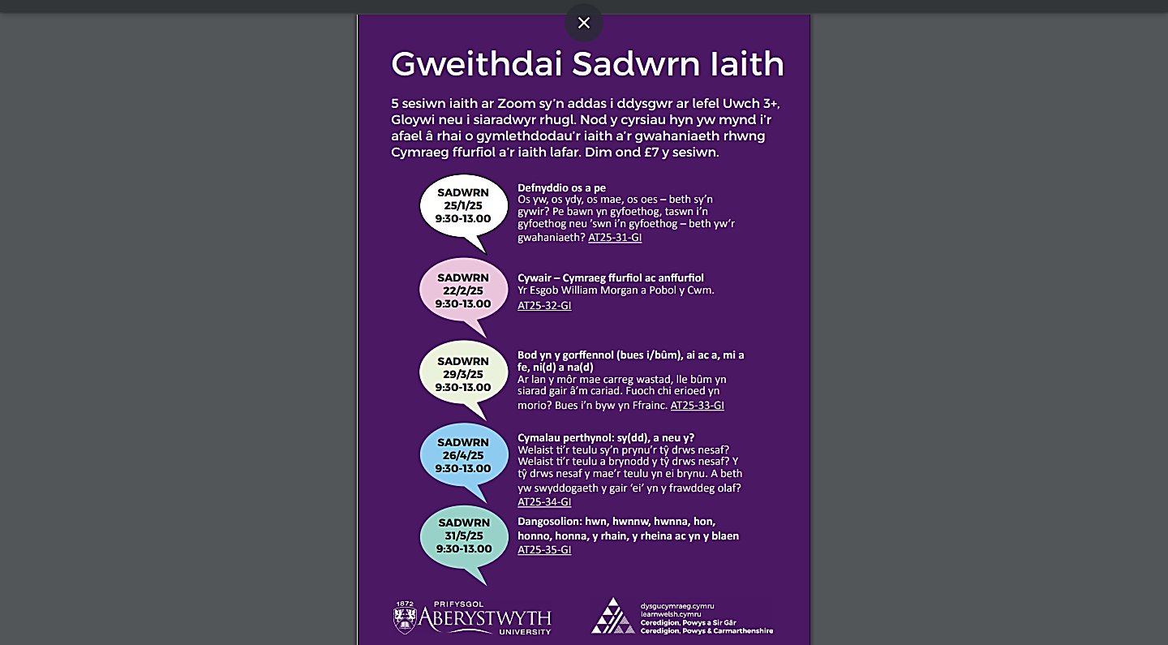

Slide 14

Sarian Thomas-Jones
Work Welsh Co-ordinator/Cydlynydd Cymraeg Gwaith
Learning and Skills Directorate / Cyfarwyddiaeth Dysgu a Sgiliau
Vale of Glamorgan Council / Cyngor Bro Morgannwg
tel / ffôn: 07936 601 188
e-mail / e-bost: sthomas-jones@valeofglamorgan.gov.uk
dysgucymraeg.cymru/yfro
learnwelsh@valeofglamorgan.gov.uk
01446 730402

