Slide 1
World AIDS Day 2023
The story of HIV

Slide 2
Overview
What is World AIDS Day?
What is HIV?
HIV treatment
HIV prevention
HIV in the UK
Living with HIV
How NAT helps
How you can get involved

Slide 3
What is World AIDS Day?
World AIDS Day is held every year on 1 December to raise awareness about HIV.
World AIDS Day is a day to…
Show support for people living with HIV
Remember those who have lost their lives because of HIV
To learn the facts and realities of HIV today, in the UK and worldwide.

Slide 4
What is HIV?
HIV is a virus that attacks the body's immune system. It stands for Human Immunodeficiency Virus (HIV).​
​
​
AIDS stands for Acquired Immune Deficiency Syndrome. It is a serious illness that can develop when HIV damages the immune system to such an extent that it can no longer fight off a range of infections it would normally cope with. ​
HIV is the not the same as AIDS. ​
AIDS only develops if HIV is left untreated.

Slide 5
HIV treatment
HIV stays in the body for life, but treatment can keep the virus under control and the immune system healthy. Without medication, people with HIV can develop AIDS.
Treatment is now so effective that it reduces someone’s viral load to undetectable levels within about 6 months, maintaining a healthy immune system and ensuring that they cannot pass on the virus.
Image Source: CDC

Slide 6
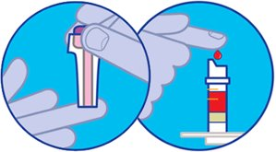
HIV prevention
Using condoms
#KnowYourStatus
Regular testing and taking PrEP or PEP if you’re at high risk for HIV infection
Undetectable = Untransmissible
Don’t share needles, syringes, or injecting equipment

Slide 7
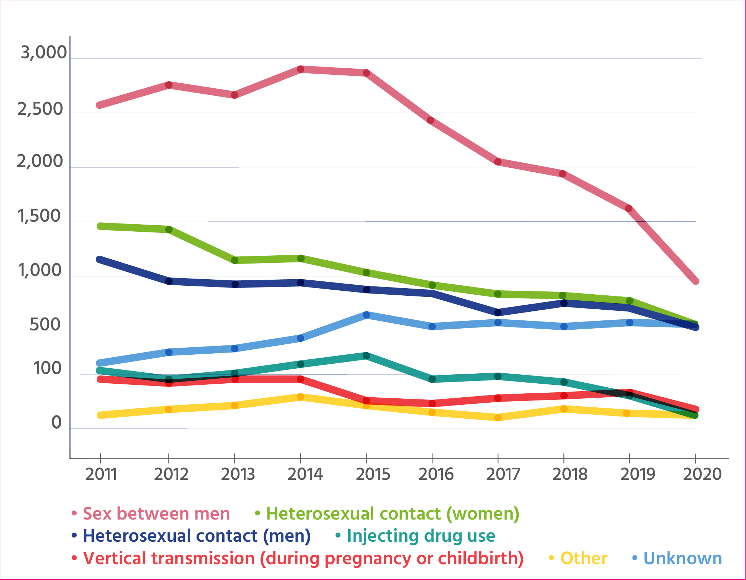
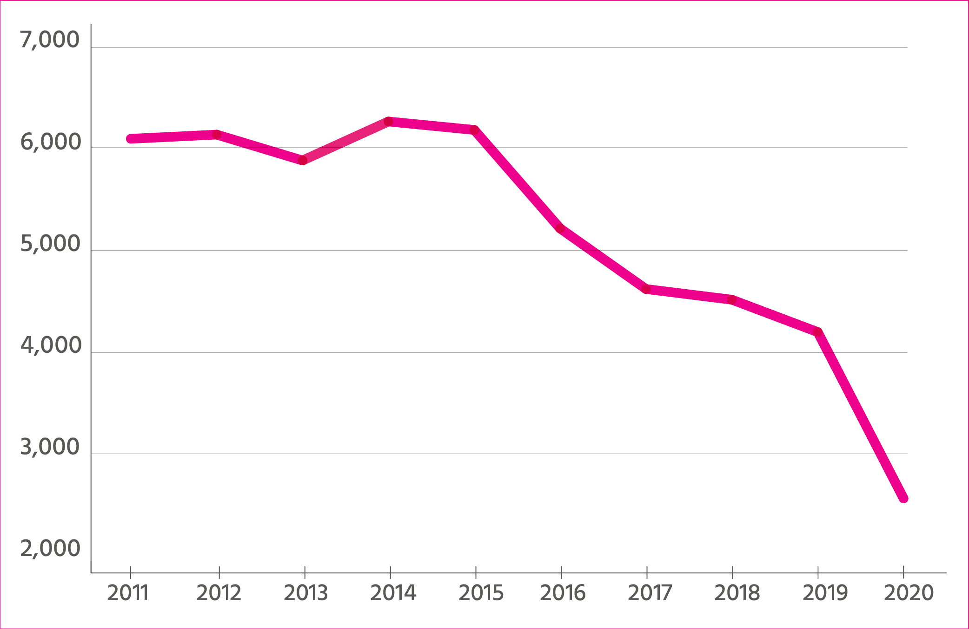
The WHO estimates there were 39 million people globally living with HIV in 2022
Modes of HIV transmission in England
New HIV diagnoses in the UK by year
Image source: NAM Aidsmap

Slide 8
HIV in the UK
In 2019, it was estimated that there are 105,200 people living with HIV in the UK.
94% of these people are diagnosed, and therefore know that they have HIV. This means that around 1 in 16 people living with HIV in the UK do not know that they have the virus.
98% of people diagnosed with HIV in the UK are engaged in care and on treatment, and 97% of those engaged and on treatment are virally suppressed which means they can’t pass the virus on.

Slide 9
Living with HIV
HIV Stigma: When people living with HIV are judged and treated badly because of prejudice and assumptions about HIV.
National AIDS Trust 2023 #StandUpToHIVStigma Campaign
Notes:
Although we now have great treatment and people living with HIV can live long and healthy lives, they still experience HIV stigma.
When people living with HIV are judged and treated badly because of prejudice and assumptions about HIV, we call this ‘HIV stigma’.
Stigma persists because many people don’t understand the reality of HIV and are scared of it.
But people living with HIV deserve our respect and dignity, just like anyone else.

Slide 10
Living with HIV
1 in 8 said they had never told anyone about their HIV status other than healthcare professionals
1 in 5 people needed help with loneliness and isolation in the past year
1 in 3 worried that they would be treated differently to other patients
1 in 10 had actually been denied or refused a health treatment or procedure that they needed
Image source: Changing Perceptions
Notes:
Although we now have great treatment and people living with HIV can live long and healthy lives, they still experience HIV stigma.
When people living with HIV are judged and treated badly because of prejudice and assumptions about HIV, we call this ‘HIV stigma’.
Stigma persists because many people don’t understand the reality of HIV and are scared of it.
But people living with HIV deserve our respect and dignity, just like anyone else.

Slide 11
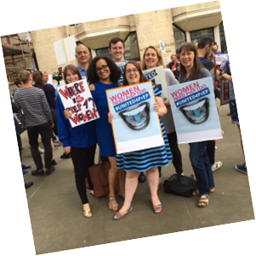
How NAT helps
We bring together people living with HIV, politicians and other important stakeholders to defend rights and secure lasting change.
We research, make resources and then recommendations.
We champion the voices of under-represented communities.
We’re not afraid to hold the powerful to account.

Slide 12
How you can support this World AIDS Day and beyond!
#RocktheRibbon
Challenge HIV stigma
Organise a fundraiser for National AIDS Trust
Join our activist network
Share our HIV education resources
Donate to National AIDS Trust

Slide 13
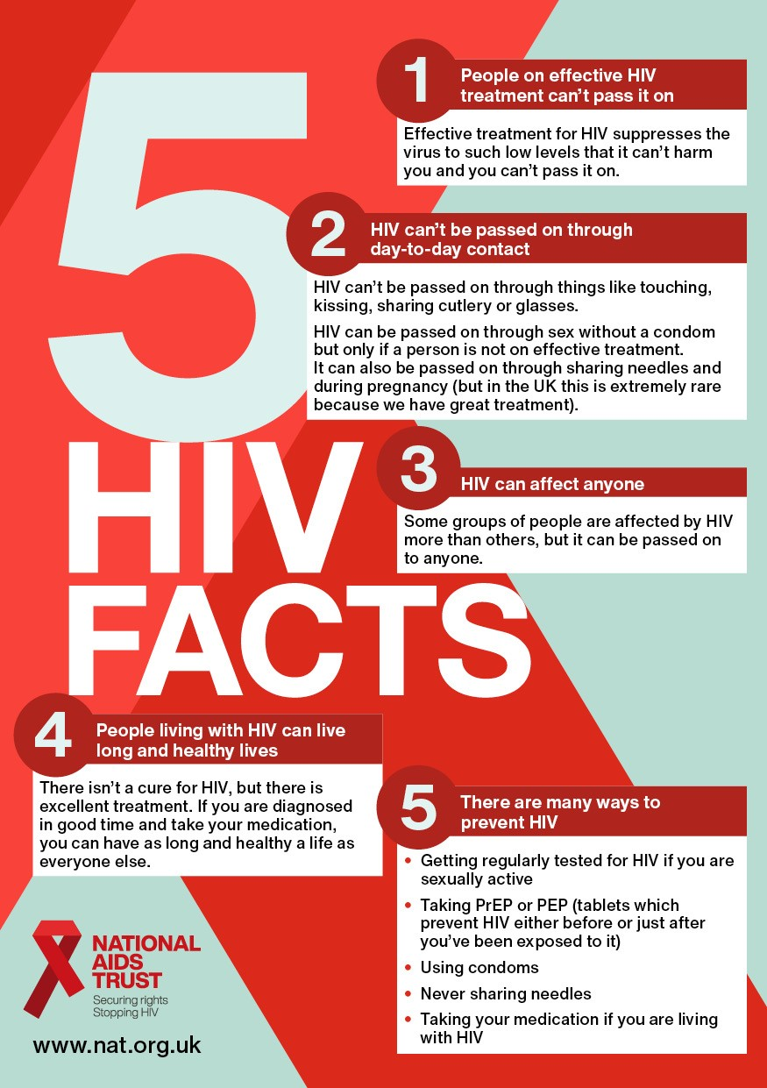
Key Takeaways

Slide 19
Thank you!

Slide 20
For further information, please contact:
Ann Clark
ann.clark@nat.org.uk
We’re the UK’s HIV rights charity. We work to stop HIV from standing in the way of health, dignity and equality, and to end new HIV transmissions. Our expertise, research and advocacy secure lasting change to the lives of people living with and at risk of HIV.
www.nat.org.uk

